Slide 1
Lecture 3:
Loss functions and Optimization

Slide 2
HW1
Due on 9/24(Tue) 11:59 pm
Submit to GradeScope (We will add you later)

Slide 3
Piazza and Gradescope
Please sign up for Piazza if you haven’t already
Please respond about our permission to use GradeScope. We need your permission to use our grading system, because it is not part of the standard UMass system. If you don’t want us to use GradeScope for your assignments contact us as soon as possible.
We need to arrange a system for grading your assignments before Assignment 1 is due.

Slide 4
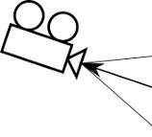

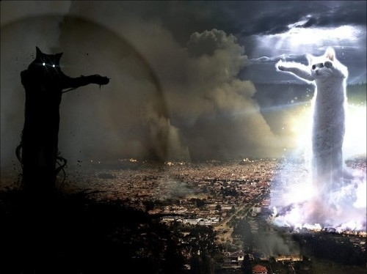
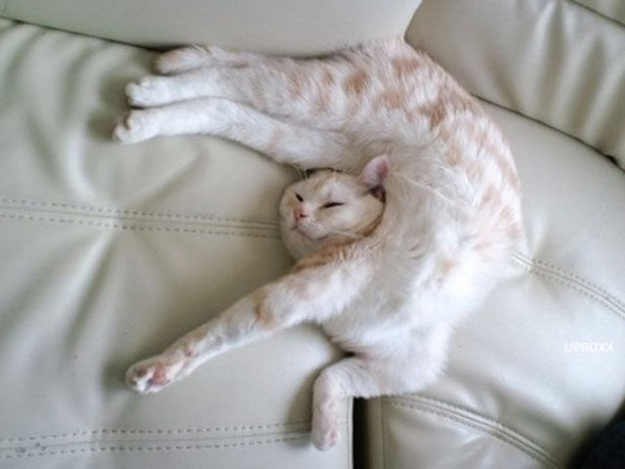
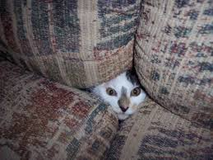
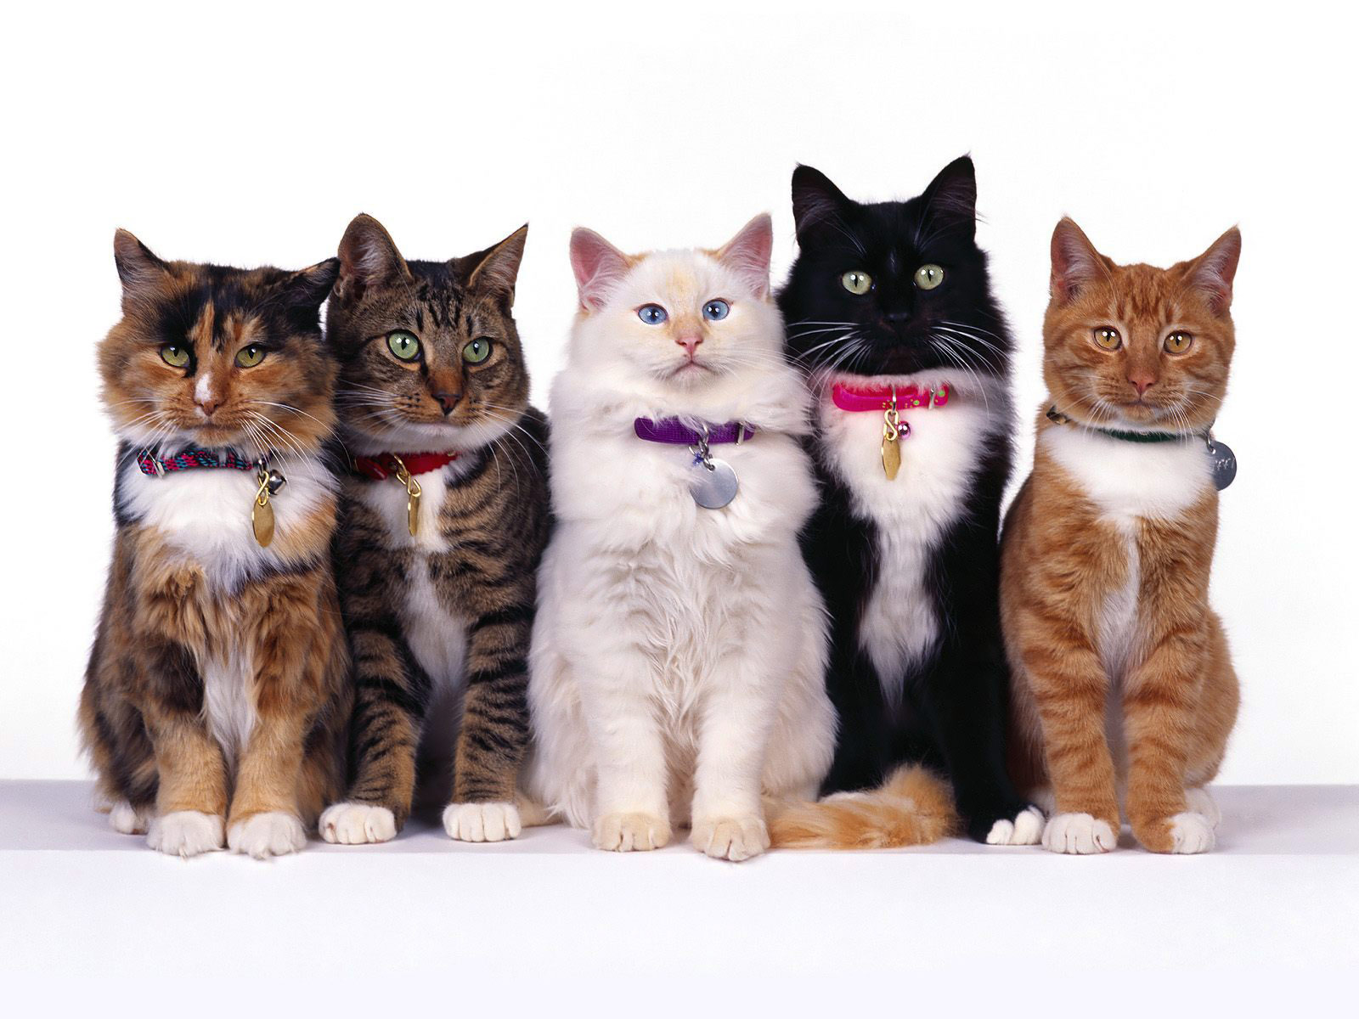
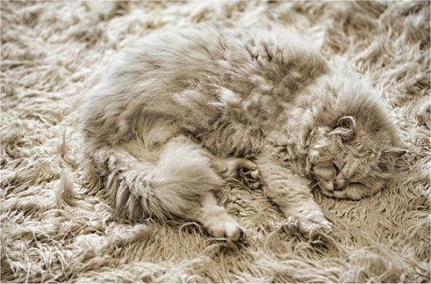
Recall from last time… Challenges in Visual Recognition
Camera pose
Illumination
Deformation
Occlusion
Background clutter
Intraclass variation

Slide 5
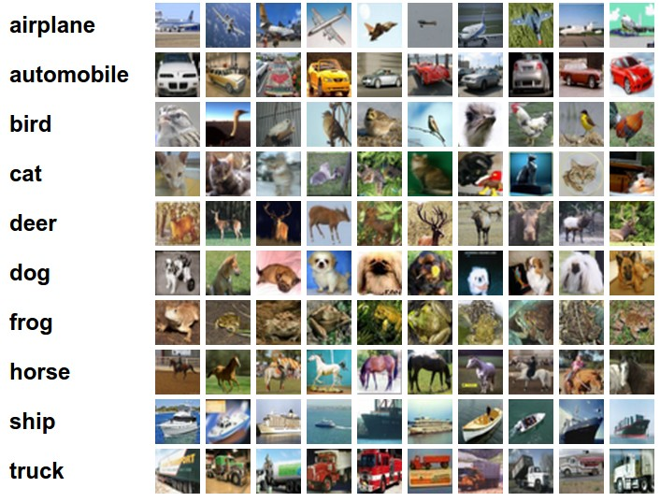
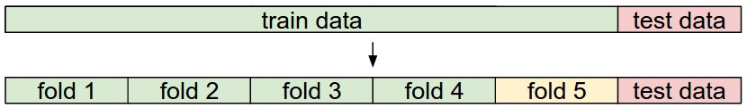
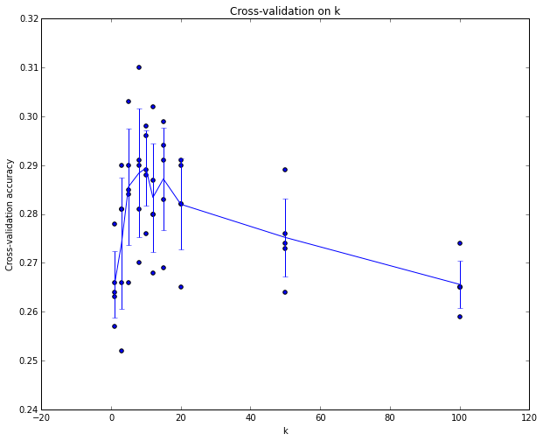
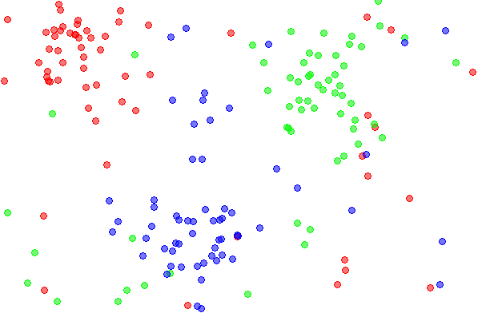
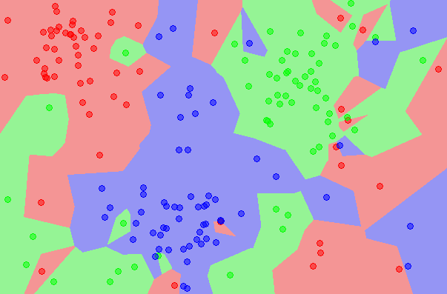
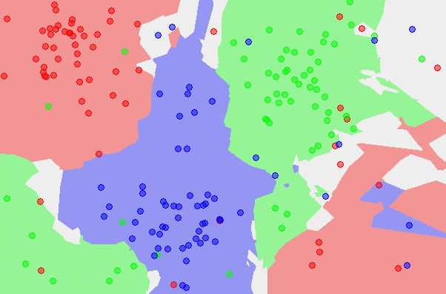
Recall from last time… data-driven approach, kNN
the data
NN classifier
5-NN classifier

Slide 6
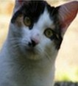
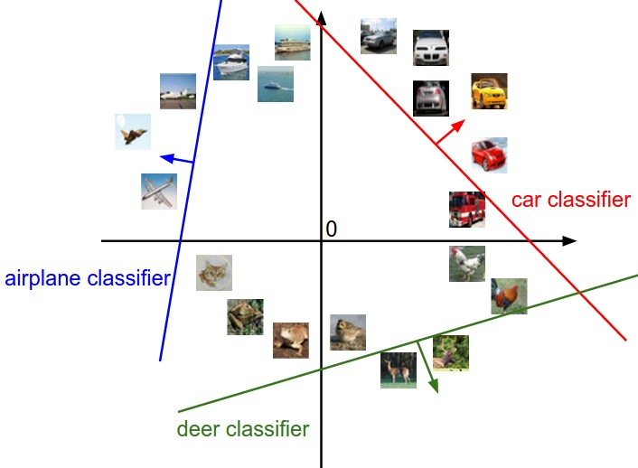
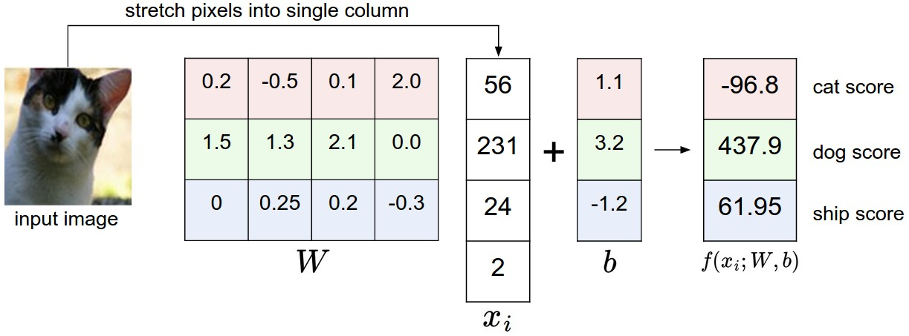
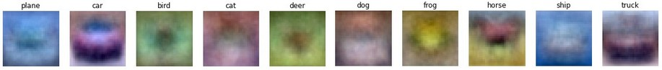
Recall from last time… Linear classifier
image
parameters
10 numbers, indicating class scores
f(x,W)
[32x32x3]
array of numbers 0...1
(3072 numbers total)

Slide 7

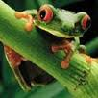
Recall from last time… Going forward: Loss function/Optimization
TODO:
Define a loss function that quantifies our unhappiness with the scores across the training data.
Come up with a way of efficiently finding the parameters that minimize the loss function. (optimization)
-3.45
-8.87
0.09
2.9
4.48
8.02
3.78
1.06
-0.36
-0.72
-0.51
6.04
5.31
-4.22
-4.19
3.58
4.49
-4.37
-2.09
-2.93
3.42
4.64
2.65
5.1
2.64
5.55
-4.34
-1.5
-4.79
6.14

Slide 8
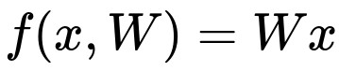
Suppose: 3 training examples, 3 classes.
With some W the scores are:
cat
3.2
1.3
2.2
car
5.1
4.9
2.5
-1.7
2.0
-3.1
frog

Slide 9
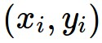
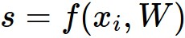

Suppose: 3 training examples, 3 classes.
With some W the scores are:
Multiclass SVM loss:
Given an example
where is the image and
where is the (integer) label,
and using the shorthand for the scores vector:
the SVM loss has the form:
cat
3.2
1.3
2.2
car
5.1
4.9
2.5
-1.7
2.0
-3.1
frog

Slide 10
Suppose: 3 training examples, 3 classes.
With some W the scores are:
Multiclass SVM loss:
Given an example
where is the image and
where is the (integer) label,
and using the shorthand for the scores vector:
the SVM loss has the form:
cat
3.2
1.3
2.2
car
5.1
4.9
2.5
= max(0, 5.1 - 3.2 + 1)
+max(0, -1.7 - 3.2 + 1)
= max(0, 2.9) + max(0, -3.9)
= 2.9 + 0
= 2.9
-1.7
2.0
-3.1
frog
Losses:
2.9

Slide 11
Suppose: 3 training examples, 3 classes.
With some W the scores are:
Multiclass SVM loss:
Given an example
where is the image and
where is the (integer) label,
and using the shorthand for the scores vector:
the SVM loss has the form:
cat
3.2
1.3
2.2
car
5.1
4.9
2.5
= max(0, 1.3 - 4.9 + 1)
+max(0, 2.0 - 4.9 + 1)
= max(0, -2.6) + max(0, -1.9)
= 0 + 0
= 0
-1.7
2.0
-3.1
frog
Losses:
2.9
0

Slide 12
Suppose: 3 training examples, 3 classes.
With some W the scores are:
Multiclass SVM loss:
Given an example
where is the image and
where is the (integer) label,
and using the shorthand for the scores vector:
the SVM loss has the form:
cat
3.2
1.3
2.2
car
5.1
4.9
2.5
= max(0, 2.2 - (-3.1) + 1)
+max(0, 2.5 - (-3.1) + 1)
= max(0, 6.3) + max(0, 6.6)
= 6.3 + 6.6
= 12.9
-1.7
2.0
-3.1
frog
Losses:
2.9
0
12.9

Slide 13
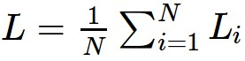
Suppose: 3 training examples, 3 classes.
With some W the scores are:
Multiclass SVM loss:
Given an example
where is the image and
where is the (integer) label,
and using the shorthand for the scores vector:
the SVM loss has the form:
and the full training loss is the mean over all examples in the training data:
cat
3.2
1.3
2.2
car
5.1
4.9
2.5
-1.7
2.0
-3.1
frog
L = (2.9 + 0 + 10.9)/3
= 5.3
Losses:
2.9
0
12.9

Slide 14
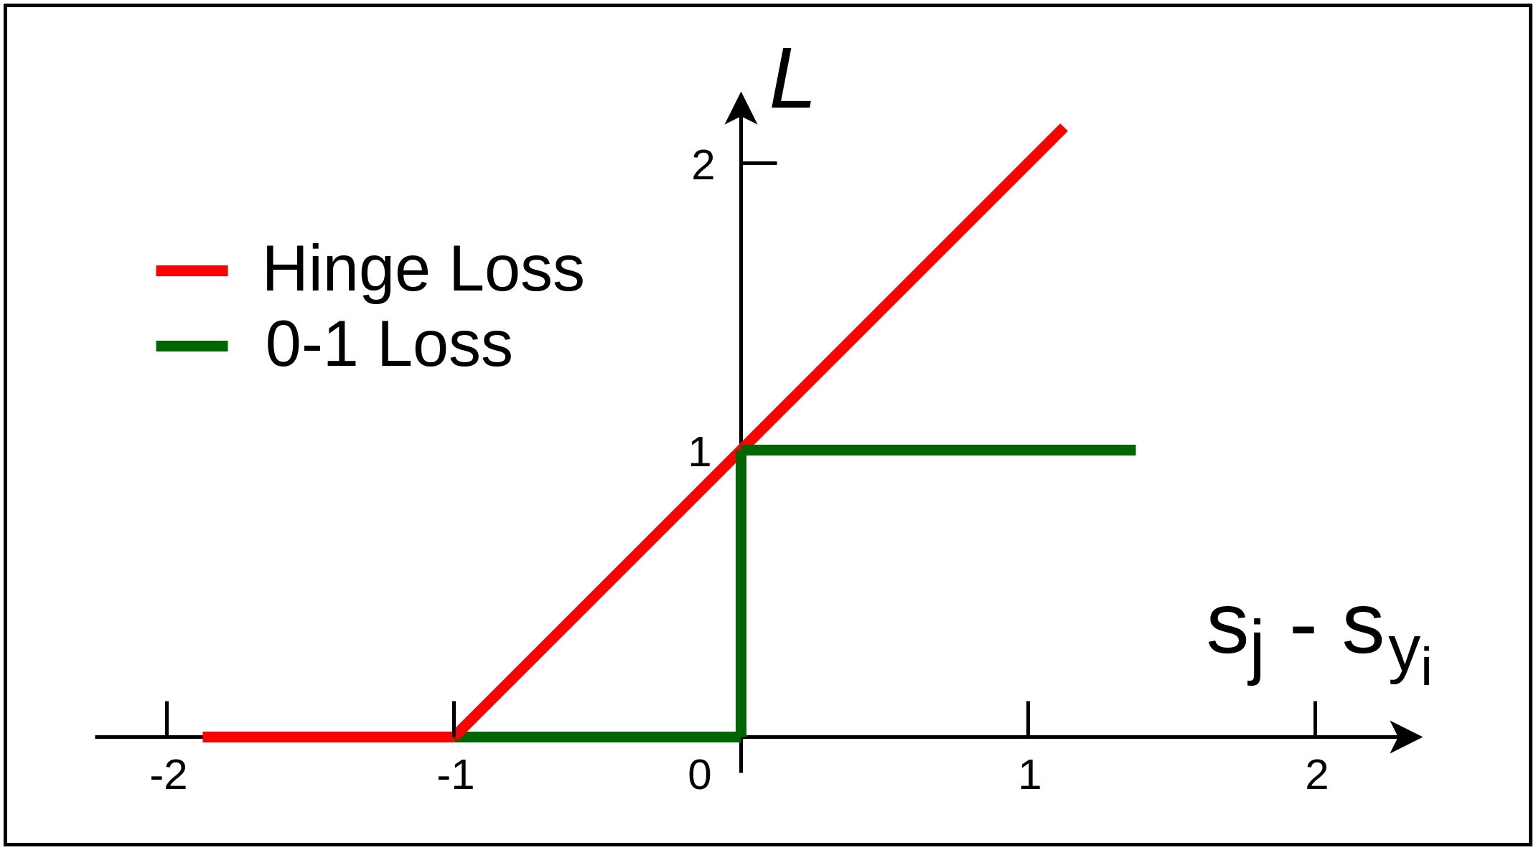

Slide 15
Multiclass SVM Loss:
What happens to loss if car scores change a bit?
What is the min/max possible loss?
At initialization W is small so all s ≈ 0. What is the loss?
What if the sum was over all classes? (including j = y_i)
What if we used mean instead of sum?
What if we used squared SVM loss?
cat
3.2
1.3
2.2
car
5.1
4.9
2.5
frog
-1.7
2.0
-3.1
Losses:
2.9
0
12.9

Slide 16
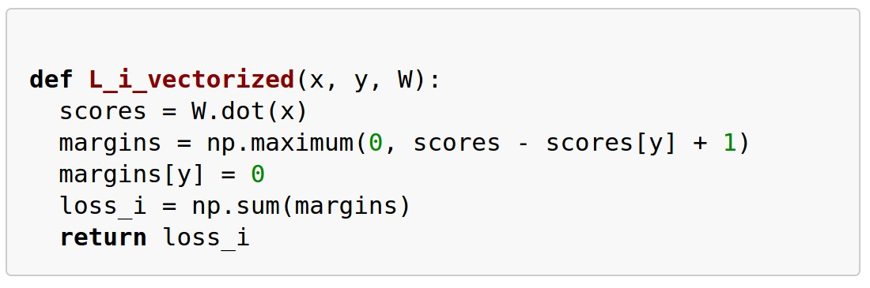
Example numpy code:

Slide 17
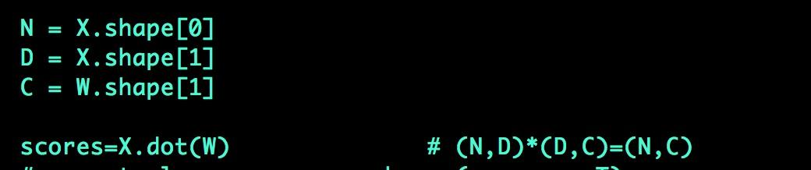
Coding tip: Keep notes on dimensions:

Slide 18

There is a “bug” with the loss:
E.g. Suppose that we found a W such that L = 0.
Is this W unique?

Slide 19
Suppose: 3 training examples, 3 classes.
With some W the scores are:
Before:
= max(0, 1.3 - 4.9 + 1)
+max(0, 2.0 - 4.9 + 1)
= max(0, -2.6) + max(0, -1.9)
= 0 + 0
= 0
cat
3.2
1.3
2.2
With W twice as large:
5.1
4.9
2.5
= max(0, 2.6 - 9.8 + 1)
+max(0, 4.0 - 9.8 + 1)
= max(0, -6.2) + max(0, -4.8)
= 0 + 0
= 0
car
-1.7
2.0
-3.1
frog
Losses:
2.9
0
12.9

Slide 20
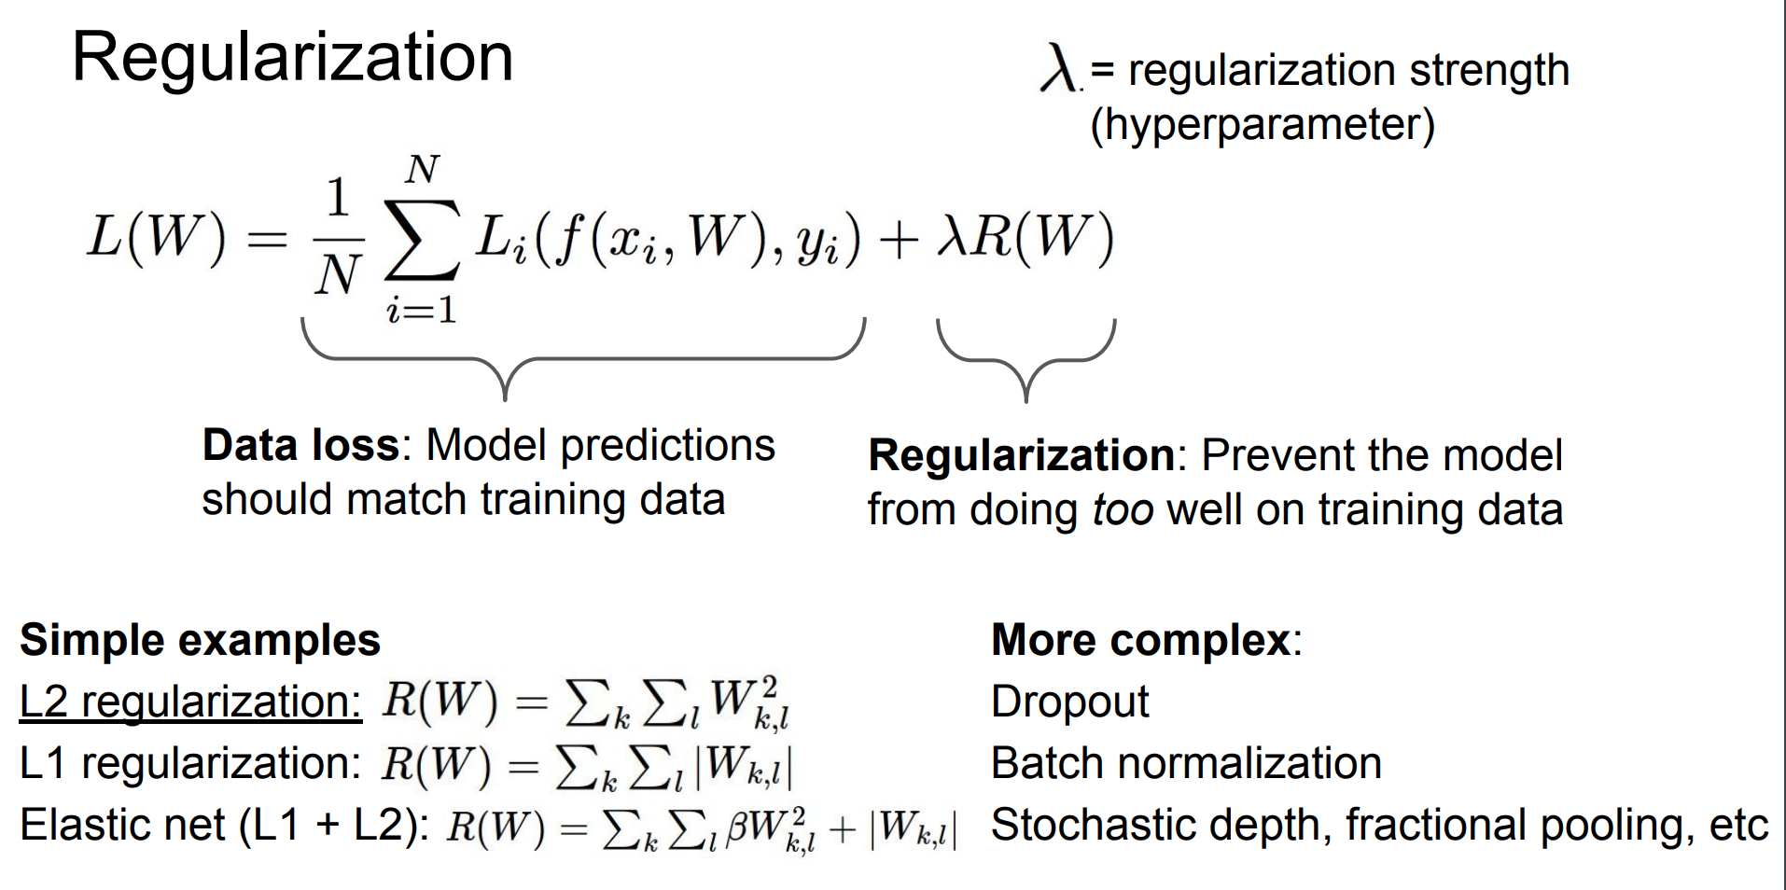

Slide 21
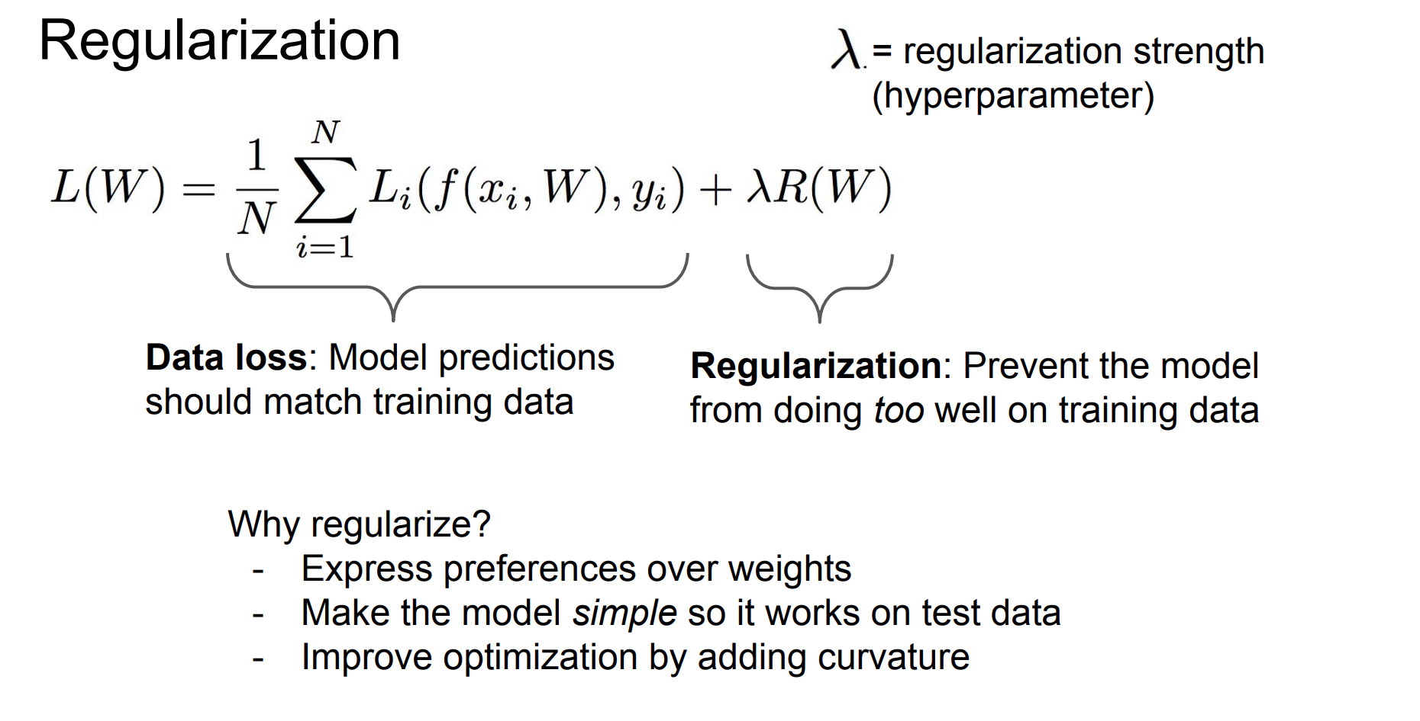

Slide 22
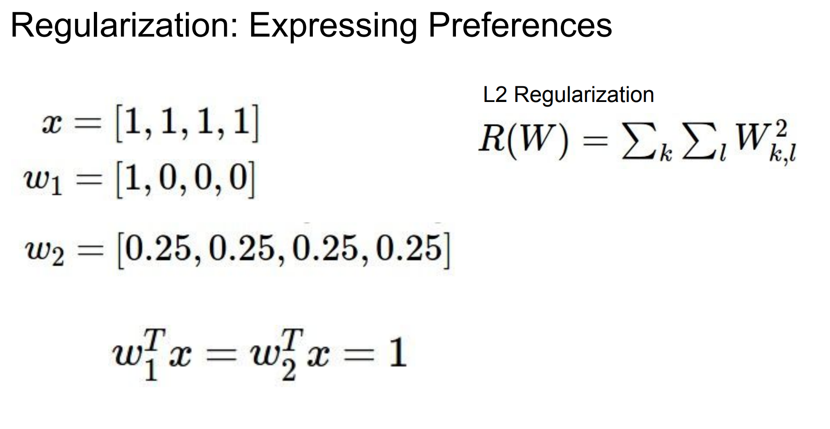

Slide 23
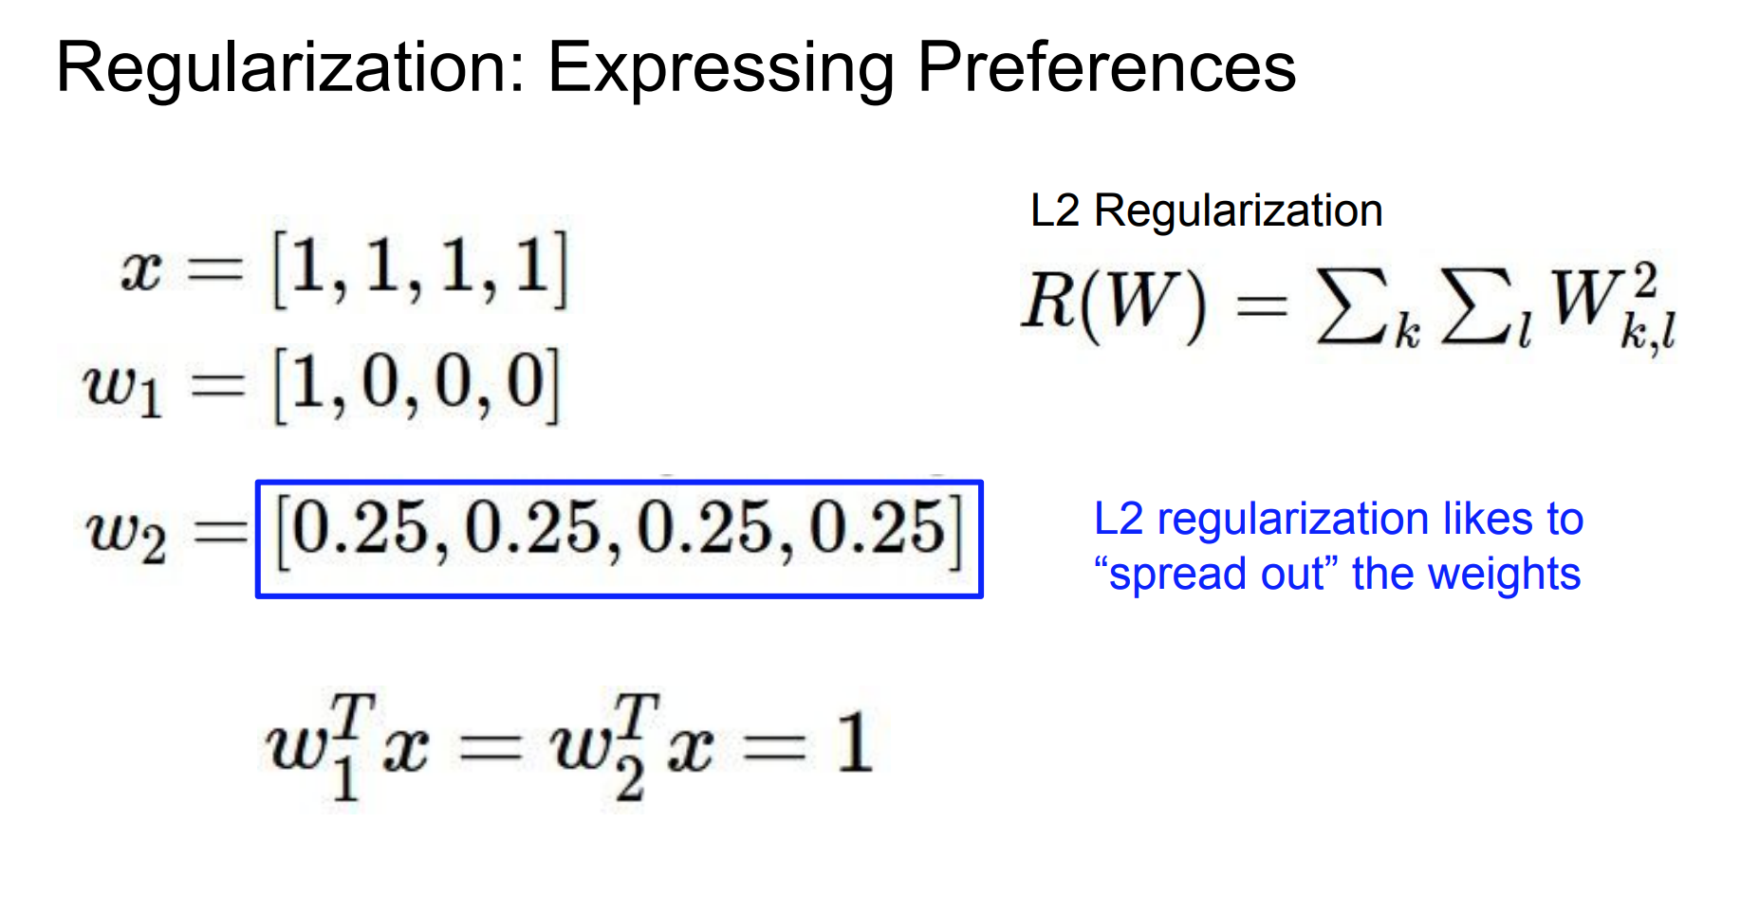

Slide 24
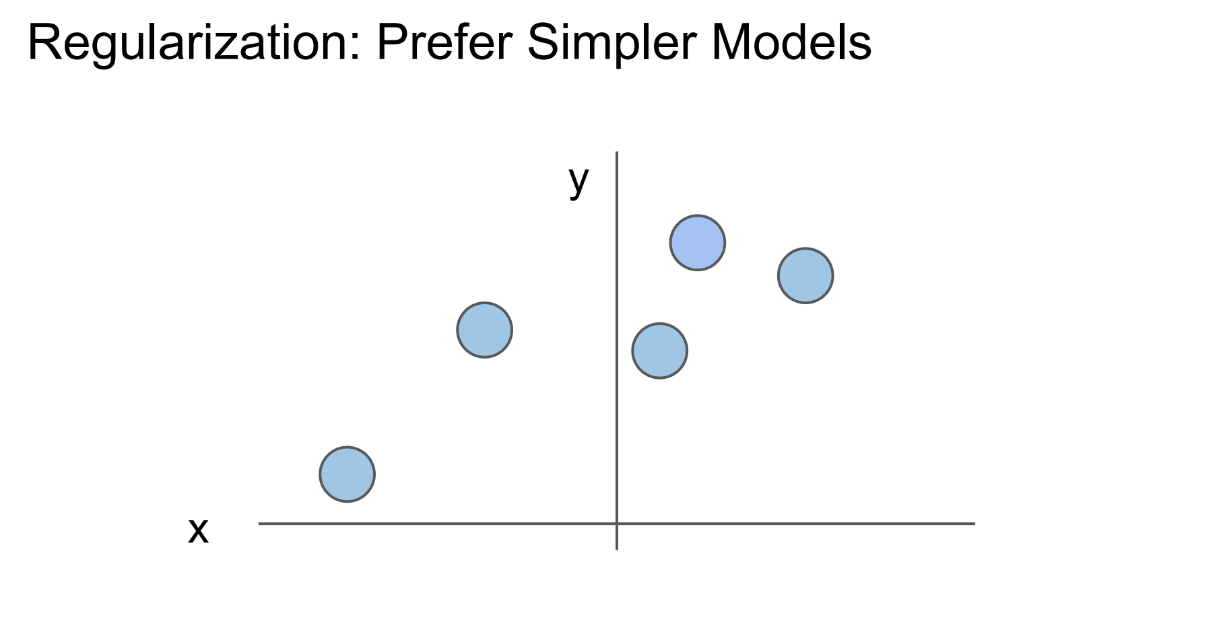

Slide 25
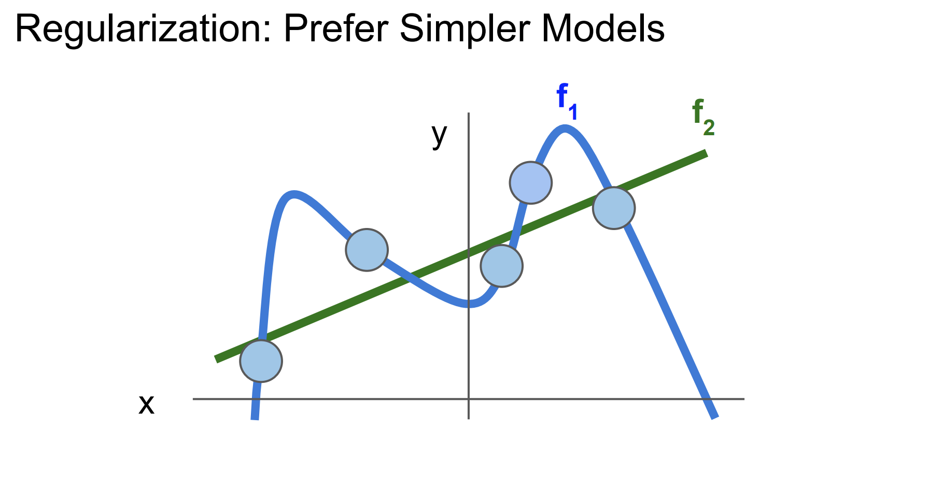

Slide 26
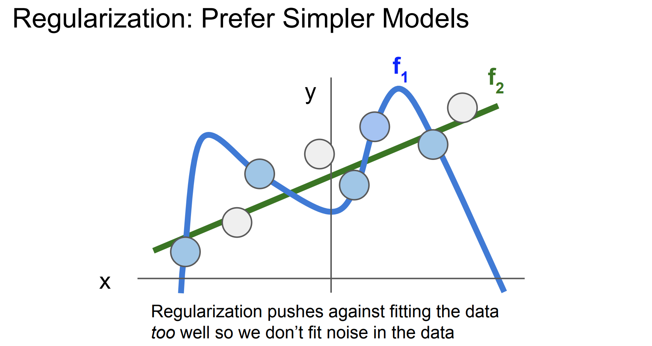

Slide 27
Softmax Classifier (Multinomial Logistic Regression)
cat
3.2
car
5.1
-1.7
frog

Slide 28
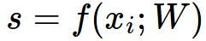
Softmax Classifier (Multinomial Logistic Regression)
scores = unnormalized log probabilities of the classes.
cat
3.2
car
5.1
-1.7
frog

Slide 29
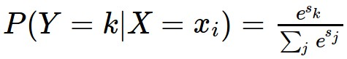
Softmax Classifier (Multinomial Logistic Regression)
scores = unnormalized log probabilities of the classes.
where
cat
3.2
car
5.1
-1.7
frog

Slide 30
Softmax Classifier (Multinomial Logistic Regression)
scores = unnormalized log probabilities of the classes.
where
cat
3.2
Softmax function
car
5.1
-1.7
frog

Slide 31
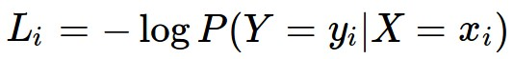
Softmax Classifier (Multinomial Logistic Regression)
scores = unnormalized log probabilities of the classes.
Want to maximize the log likelihood, or (for a loss function)
to minimize the negative log likelihood of the correct class:
where
cat
3.2
car
5.1
-1.7
frog

Slide 32
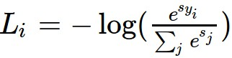
Softmax Classifier (Multinomial Logistic Regression)
scores = unnormalized log probabilities of the classes.
Want to maximize the log likelihood, or (for a loss function)
to minimize the negative log likelihood of the correct class:
where
cat
3.2
car
5.1
-1.7
frog
in summary:

Slide 33
Softmax Classifier (Multinomial Logistic Regression)
cat
3.2
car
5.1
-1.7
frog
unnormalized log probabilities

Slide 34
Softmax Classifier (Multinomial Logistic Regression)
unnormalized probabilities
cat
3.2
24.5
exp
car
5.1
164.0
-1.7
0.18
frog
unnormalized log probabilities

Slide 35
Softmax Classifier (Multinomial Logistic Regression)
unnormalized probabilities
cat
3.2
24.5
0.13
exp
normalize
car
5.1
164.0
0.87
-1.7
0.18
0.00
frog
probabilities >0, sum to 1
unnormalized log probabilities

Slide 36
Softmax Classifier (Multinomial Logistic Regression)
unnormalized probabilities
cat
3.2
24.5
0.13
L_i = -log(0.13)
= 0.89
exp
normalize
car
5.1
164.0
0.87
-1.7
0.18
0.00
frog
unnormalized log probabilities
probabilities

Slide 37
Softmax Classifier (Multinomial Logistic Regression)
unnormalized probabilities
cat
3.2
24.5
0.13
L_i = -log(0.13)
= 0.89
exp
normalize
car
5.1
164.0
0.87
-1.7
0.18
0.00
frog
unnormalized log probabilities
probabilities

Slide 38
Softmax Classifier (Multinomial Logistic Regression)
Q: What is the min/max possible loss L_i?
unnormalized probabilities
cat
3.2
24.5
0.13
L_i = -log(0.13)
= 0.89
exp
normalize
car
5.1
164.0
0.87
-1.7
0.18
0.00
frog
unnormalized log probabilities
probabilities

Slide 39
Softmax Classifier (Multinomial Logistic Regression)
Q2: usually at initialization W are small numbers, so all s ~= 0. What is the loss?
unnormalized probabilities
cat
3.2
24.5
0.13
L_i = -log(0.13)
= 0.89
exp
normalize
car
5.1
164.0
0.87
-1.7
0.18
0.00
frog
unnormalized log probabilities
probabilities

Slide 40
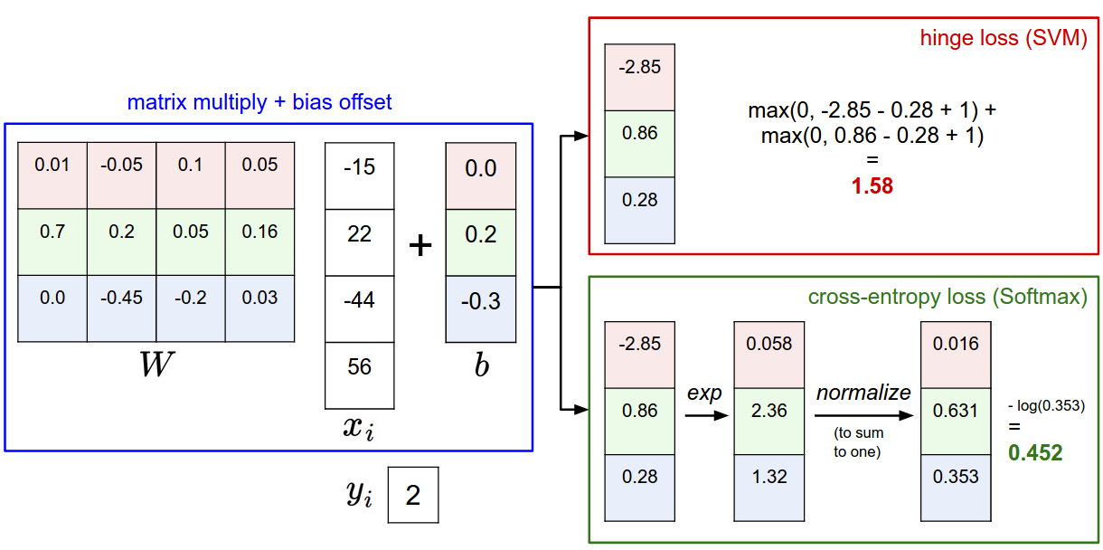

Slide 41
Softmax vs. SVM

Slide 42
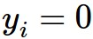
Softmax vs. SVM
assume scores:
[10, -2, 3]
[10, 9, 9]
[10, -100, -100]
and
Q: Suppose I take a datapoint and I jiggle a bit (changing its score slightly). What happens to the loss in both cases?

Slide 43
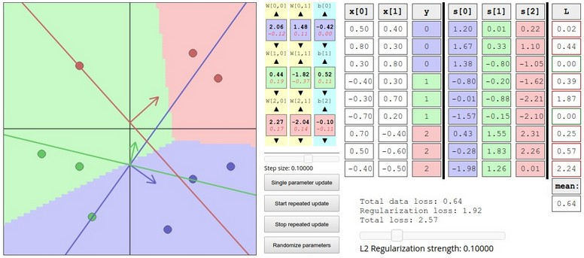
Interactive Web Demo time....
http://vision.stanford.edu/teaching/cs231n/linear-classify-demo/

Slide 44
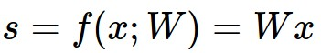
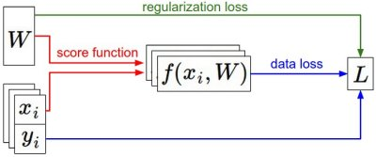
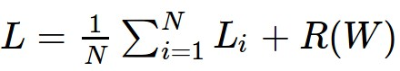
Recap
We have some dataset of (x,y)
We have a score function:
We have a loss function:
e.g.
Softmax
SVM
Full loss

Slide 45
Optimization

Slide 46
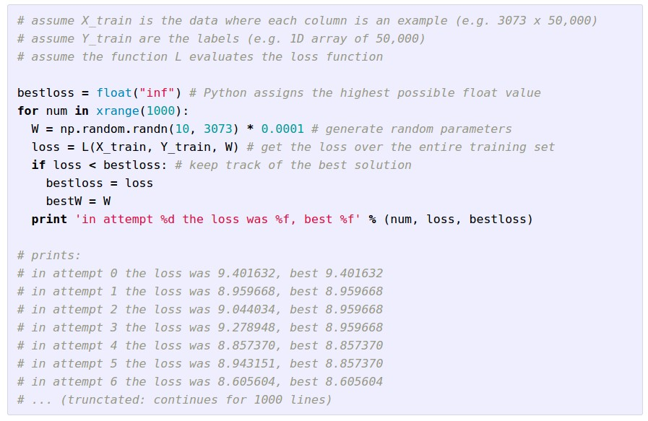
Strategy #1: A first very bad idea solution: Random search

Slide 47
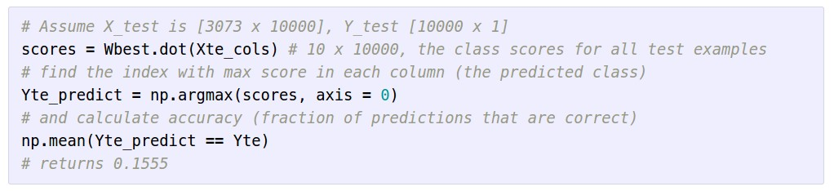
Let’s see how well this works on the test set...
15.5% accuracy! not bad!
(SOTA is ~95%)

Slide 48
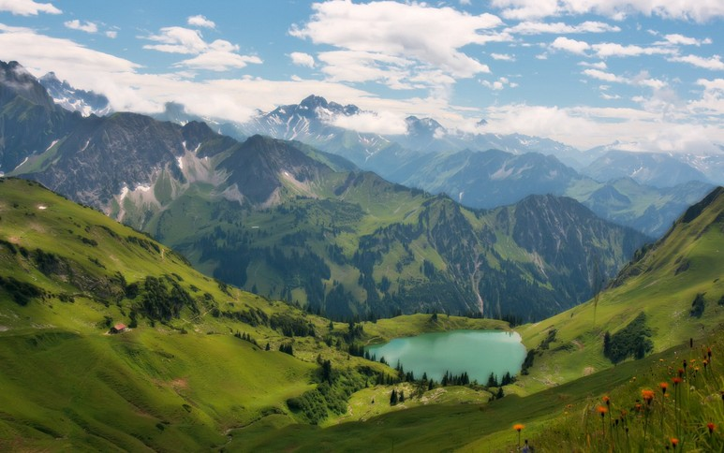

Slide 49


Slide 50
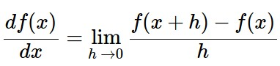
Strategy #2: Follow the slope
In 1-dimension, the derivative of a function:
In multiple dimensions, the gradient is the vector of (partial derivatives).

Slide 51
current W:
[0.34,
-1.11,
0.78,
0.12,
0.55,
2.81,
-3.1,
-1.5,
0.33,…]
loss 1.25347
gradient dW:
[?,
?,
?,
?,
?,
?,
?,
?,
?,…]

Slide 52
current W:
[0.34,
-1.11,
0.78,
0.12,
0.55,
2.81,
-3.1,
-1.5,
0.33,…]
loss 1.25347
W + h (first dim):
[0.34 + 0.0001,
-1.11,
0.78,
0.12,
0.55,
2.81,
-3.1,
-1.5,
0.33,…]
loss 1.25322
gradient dW:
[?,
?,
?,
?,
?,
?,
?,
?,
?,…]

Slide 53
current W:
[0.34,
-1.11,
0.78,
0.12,
0.55,
2.81,
-3.1,
-1.5,
0.33,…]
loss 1.25347
W + h (first dim):
[0.34 + 0.0001,
-1.11,
0.78,
0.12,
0.55,
2.81,
-3.1,
-1.5,
0.33,…]
loss 1.25322
gradient dW:
[-2.5,
?,
?,
?,
?,
?,
?,
?,
?,…]
(1.25322 - 1.25347)/0.0001
= -2.5

Slide 54
current W:
[0.34,
-1.11,
0.78,
0.12,
0.55,
2.81,
-3.1,
-1.5,
0.33,…]
loss 1.25347
W + h (second dim):
[0.34,
-1.11 + 0.0001,
0.78,
0.12,
0.55,
2.81,
-3.1,
-1.5,
0.33,…]
loss 1.25353
gradient dW:
[-2.5,
?,
?,
?,
?,
?,
?,
?,
?,…]

Slide 55
current W:
[0.34,
-1.11,
0.78,
0.12,
0.55,
2.81,
-3.1,
-1.5,
0.33,…]
loss 1.25347
W + h (second dim):
[0.34,
-1.11 + 0.0001,
0.78,
0.12,
0.55,
2.81,
-3.1,
-1.5,
0.33,…]
loss 1.25353
gradient dW:
[-2.5,
0.6,
?,
?,
?,
?,
?,
?,
?,…]
(1.25353 - 1.25347)/0.0001
= 0.6

Slide 56
current W:
[0.34,
-1.11,
0.78,
0.12,
0.55,
2.81,
-3.1,
-1.5,
0.33,…]
loss 1.25347
W + h (third dim):
[0.34,
-1.11,
0.78 + 0.0001,
0.12,
0.55,
2.81,
-3.1,
-1.5,
0.33,…]
loss 1.25347
gradient dW:
[-2.5,
0.6,
?,
?,
?,
?,
?,
?,
?,…]

Slide 57
current W:
[0.34,
-1.11,
0.78,
0.12,
0.55,
2.81,
-3.1,
-1.5,
0.33,…]
loss 1.25347
W + h (third dim):
[0.34,
-1.11,
0.78 + 0.0001,
0.12,
0.55,
2.81,
-3.1,
-1.5,
0.33,…]
loss 1.25347
gradient dW:
[-2.5,
0.6,
0,
?,
?,
?,
?,
?,
?,…]
(1.25347 - 1.25347)/0.0001
= 0

Slide 58
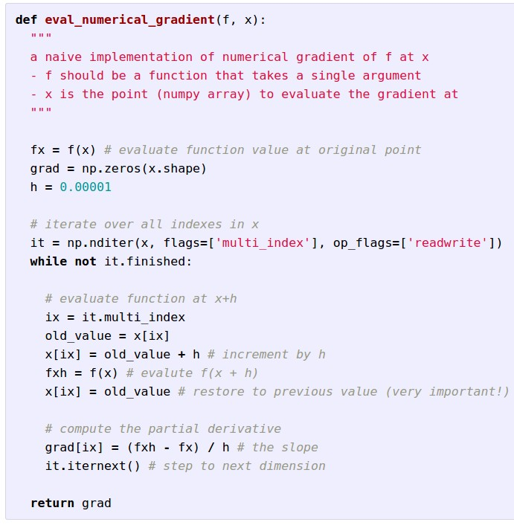
Evaluating the
gradient numerically

Slide 59
Evaluating the
gradient numerically
approximate
very slow to evaluate

